Slide 1
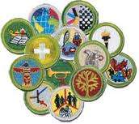
Troop 805 Merit Badge Counselor Training

Slide 2
Learning objectives
Understand the aims of Scouting, the advancement process, and the merit badge counselor’s role
Know a merit badge counselor’s duties and responsibilities to the Scout
Understand and complete the requirements to be a registered merit badge counselor
List some tips for counseling
Successfully guide a Scout through the merit badge process for filling out their blue card

Slide 3
The Advancement Program
4 Steps Learning - Testing - Reviewing - Recognition
Provides a unique, non-classroom-based educational tool that helps young men grow into adults of character.
Allows the Scout to progress at his own rate.
Accepting the challenge encourages Scouts.
Shows that there are recognition and rewards for perseverance.
Encourages Scouting ideals: the Oath, Law, Motto, and Slogan.

Slide 4
What are Merit Badges
~130 merit badges are offered, ranging from American Business to Woodwork
Each merit badge has specific, detailed requirements for completion.
Scouts must earn a specified number of merit badges to earn the ranks of Star, Life, Eagle, and
Eagle Palms.
The following merit badges require special qualifications and/or certifications to counsel:
Canoeing, Climbing, Lifesaving, Rifle Shooting, Rowing, SCUBA Diving, Shotgun Shooting, Snow Sports, Swimming, and Whitewater
21 merit badges are required for the rank of Eagle Scout, 13 of which are specifically mandated:
1. First Aid
2. Citizenship in the Community
3. Citizenship in the Nation
4. Citizenship in the World
5. Communications
6. Personal Fitness
7. Emergency Preparedness OR Lifesaving
8. Environmental Science OR Sustainability
9. Personal Management
10. Swimming OR Hiking OR Cycling
11. Camping
12. Family Life
13. Cooking

Slide 5
Eagle Badges versus Elective Badges
Eagle Badges
Silver borders
Elective Badges
Green borders
Citizenship
In the World
First Aid
Personal Management
Dog Care
Orienteering Wilderness
Survival

Slide 6
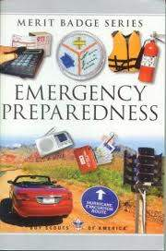
Merit Badge Pamphlets (Books)
Merit Badge Requirements in merit badge pamphlet
May be purchased by the Scout
May be available at a library
May be in the unit library
Blue Border
Elective Merit Badge
Silver Border
Eagle Merit Badge

Slide 7
The Merit Badge Process
The Scout (not an adult) will contact you to schedule a meeting.
At the meeting
Introduce yourself. Tell why you counsel this Badge!
Determine:
Preparedness: Signed Merit Badge Card?
Did he read the Merit Badge pamphlet?
What does he already know about the subject?
Has he been researching possible projects if required?
Discuss requirements.
Set short- and long-term goals.
Scouts may use school assignments if they ‘fit’ well.
Set the next meeting date.

Slide 8
The Merit Badge Process
Counselor asks Scout to bring:
Signed Merit Badge card
Merit Badge Pamphlet
Projects in progress, samples of school projects, ideas for requirements
Scout and Counselor decide on requirements, projects, goals.
The Scout does work on own or with other Scouts; with help from Counselor. May require several work days.
Counselor tests each Scout individually
Counselor records completed requirements

Slide 9
Role of Merit Badge Counselor
Assist the Scout as he plans the assigned projects and activities to meet the merit badge requirements.
Coach Scouts through interviews and demonstrations on how to do the required skills of the craft, business, or hobby.
Certify the Scout after determining whether he is qualified for the merit badge.

Slide 10
Buddy System
A Scout MUST have a buddy with him at EACH
meeting with a Merit Badge Counselor.
Buddies may be:
Another Scout
Parent or guardian
Brother / Sister
A Friend or another Relative
The Counselor’s spouse or children
A Scout can NEVER meet with a Merit Badge
Counselor ALONE.

Slide 11
Buddies and Group Instruction
Buddies
Give individual attention to each Scout during the badge.
The Counselor must meet with Scout individually to finish badge
Never meet alone with a Scout.

Slide 12
Buddies and Group Instruction
Group Counseling
(Meetings, Weekend Camp-outs, Summer Camp, High Adventure Trips, Jamborees, Camporees, Merit Badge Days, Camporees, Skills Seminars...)
Specialized facilities:
to work on appropriate equipment
to tour businesses specializing in subject matter
to meet with expert personnel
to give Scouts in rural areas access to Counselors and Badges

Slide 13
Resources
Merit Badge Worksheets are optional
Some think they are too much like school... Others love them.
Worksheets do help with understanding and organization.
If your Badge could benefit from a Worksheet, make your own, or ask the Scout to download one.
A good example:
www.meritbadge.com There are great ‘Resources’ at the end of these Worksheets.

Slide 14
Tips for Merit Badge Counselors
During the time you are working with the Scout on the Badge:
Teach skills
Scouts learn best by practicing, then teaching someone else
Scout must do what is asked in the requirements: * make * list * collect * identify * label * in the field...*
Expect “no more, no less.”
If Scout wants to do more than is required, great!
Date and initial each requirement when complete.
Follow-up on goals
When done, congratulate Scout!
Keep “Counselor’s Record”

Slide 15
Qualifications for a Merit Badge Counselor
Counselors must be 18 and registered with BSA.
Counselors must be approved by District and verified by Council before beginning
Should enjoy working with youth!
Have interest, skill, and perhaps education, in your subjects
No restriction on number of Badges you may Counsel
No limit on number of Badges earned from one Counselor
Counselors may work with any Scout, including sons and relatives

Slide 16
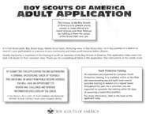
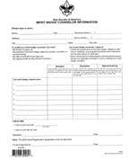
Registration for Becoming a Merit Badge Counselor
An individual must fill out a Adult Application form
Position Code is 42
There is no fee for registering as merit badge
counselor
BSA Adult Application (BSA #524-501)
An individual must take Youth Protection Training found at: www.myscouting.org
An individual must fill out the Application for a Merit Badge Counselor - (BSA #34405)

Slide 17
Registration for Becoming a Merit Badge Counselor
The Boy Scouts of America requires that all merit badge counselors take BSA Youth Protection training.
This training needs to be renewed every two years
This program addresses strategies for personal safety awareness for youth as well as adults.
BSA Youth Protection policies include
Two-deep leadership
No one-on-one contact
Respecting privacy
Reporting problems

Slide 18
Important
A separate BSA Adult Application
(along with/ the associative aforementioned forms) must be submitted by Anyone who wants to become a registered Merit Badge Counselor
regardless of whether that person is already a registered BSA Scout Leader.
(YES – We know it seems redundant!)

Slide 19
However
Currently Registered Merit Badge Counselors who want to add additional Merit Badges to the list of those that they already teach, need only to submit a new Merit Badge Counselor Information form (BSA Form # 34405)

Slide 20
Counselor Tips
A merit badge counselor can counsel any Scout, including his own son although this is discouraged in order to offer a Scout the chance to meet a diverse group of outstanding adults.
A counselor may be certified in unlimited merit badge subjects, but he or she must be approved for each one.
There is no limit on the number of merit badges that a counselor may counsel with one Scout.
However, the Scout will benefit the most from working with a variety of outstanding adults.

Slide 21
Counselor Tips
A merit badge counselor may limit his or her services to one unit but still must be approved by the council advancement committee.
Group instruction is acceptable, but each Scout must be tested and passed individually.
There is no time limit for completion of merit badges, but all work on merit badges must be completed before the Scout’s 18th birthday.

Slide 22
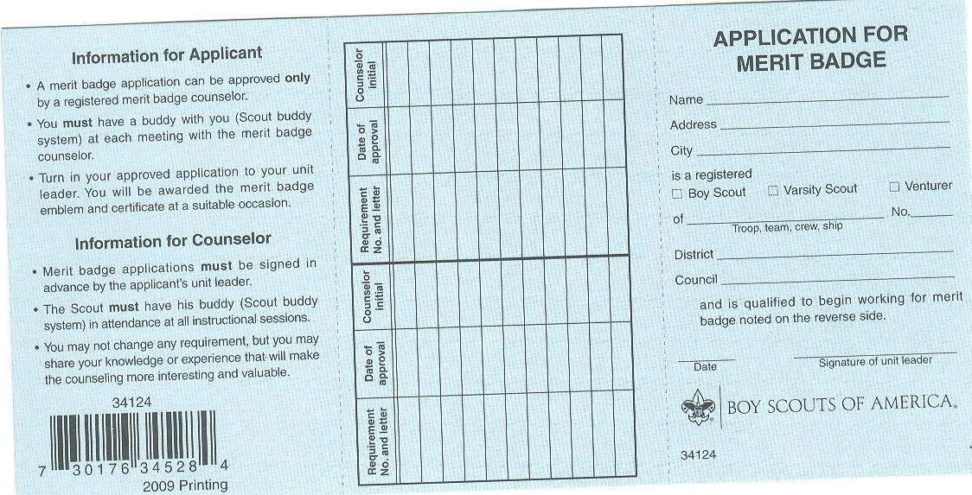
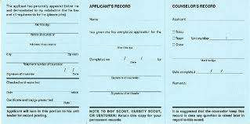
Application for Merit Badge “Blue Card”
Front
Back

Slide 23
Filling out the Blue Card
Have the scout fill out their portion of the blue card and hand to you before the second meeting.
Counselor fills out their portion and determines at this point who will be responsible for the blue card until all requirements are completed.
Have advancement chair and scoutmaster complete their portion of the blue card.
When card is completely filled out:
Separate the three sections
The advancement chair keeps the first section
The Boy Scout keeps the second section
The counselor keeps the third section

Slide 24
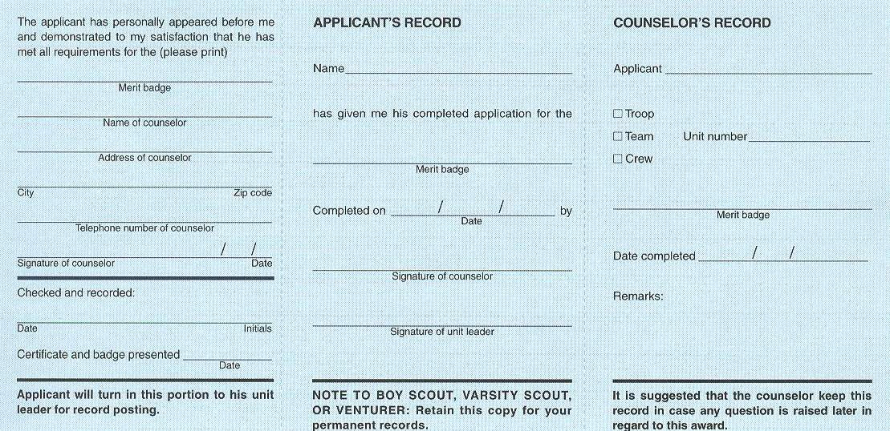
Filling out the Blue Card
1) The Scout fills out the personal data on both sides of card
2) The Scoutmaster signs front of card before Scout begins to work on badge
1
1
3
2
3
2
3) The Counselor writes in the req. number, date, and initials whenever the Scout completes a requirement
4) The Unit Advancement Chair signs and records for the unit record
3
3
3
3
2
3
4 3
2
4

Slide 25
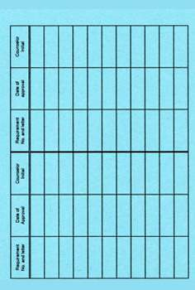
Partial Blue Card
Summer Camps, Merit Badge events, Camporees...
“Partials” never expire, but do get lost.
Unit Advancement Chair or Scout keeps on file until Scout is ready to complete or has turned 18.
Use plastic baseball card sleeves Place in 3-ring binder – {Suggestion}
1a 6-9 HP
1b 6-9 HP
1c
1d 7-18 HP
2 6-9 HP
3 7-18 HP
4a
4b 7-18 HP
This Scout has two requirements to complete.

Slide 26
Why the Blue Card Is Important
It is the official completion record recognized by BSA prior to recording and
presentation of the merit badge card by the troop.
It is the FINAL arbiter of disputes if all other records are missing, including loss
of the merit badge card that is presented with the badge.
Scouts should keep Blue Cards and the presented merit badge cards for
reference.
Counselors should keep their copy of the Blue Card in the event a Scout should
lose his copy or his merit badge card and need proof of completion.
Upon completion, Scouts turn-in their Blue Cards to their Unit Leader. He/She
may take this opportunity to congratulate the Scout upon his success in earning
the Merit Badge, and speak with the Scout about the Merit Badge (what he
liked, if it spurred any further interest, what Merit Badge he might like to tackle
next, etc..)
The Unit Leader then signs & returns the Scouts’ copy of the Blue card to him,
and turns the Units’ copy over to the Units’ Advancement personnel; for
hardcopy archival of the Card & entry into BSA’s Internet Advancement system .

Slide 27
Troubleshooting
A Counselor Should Stop Work on a Badge if
A Scout has no Blue Card
Card not signed by Scoutmaster
The Scout comes to the meeting alone (no buddy)
The Scout is not completing the requirements. Sign only completed requirements.
Summer Camp Partials are not properly filled out
If Scout is reaching age 18 please make sure has enough time to complete the requirements for the following badges: Family Life, Personal Fitness, and Personal Management. These badges have a three month requirement.
Scout has falsified charts, lists, or logs…
Parent is doing the work

Slide 28
Special Needs Scouts
Counselors may accept work from Special Needs Scouts:
Orally
By Taking Photos
By Demonstration or Drawing
By Recording
By Dictating his answers to helper

Slide 29
Special Needs Scouts
Scout may do Alternate “Eagle Required” badges
“Application for Alternate Eagle Scout Award Merit Badges”
Must have prior approval from council advancement committee
Doctor’s statement of disability must be submitted with application
Alternates are ONLY for badges he cannot complete
Record of Alternate Badges submitted with Eagle Application

Slide 30
Unit “to Do’s”
Unit Advancement Chairs
Maintain Merit Badge Counselor List supplied by the district
Work with Troop Librarian
Training the Unit’s MB Counselors:
http://scouting.org/scoutsource/boyscouts/ guideformeritbadgecounselors.aspx
Every MBC should have Youth Protection Training every 2 years.
Register each individual who mentors a merit badge.

Slide 31
Questions and Answers

Slide 32
Why does it matter that Merit Badge Counselors be registered separately?
1. Although it may seem redundant…quite simply, “it is a BSA policy.”
2. Because Merit Badge Counselor is a completely separate position from
a unit or Community Scouting District position you might already hold.
3. Because official Merit Badge Counselor records are maintained by the
Council, not the unit.
4. Because the Council must approve all MB Counselors.
5. Because BSA requires a background check of all adults who participate
in scouting
6. Because a Scout is Trustworthy. Someone from your units advancement
committee attests to the following statement, when reporting your units’ advancements and inputting it into BSA’s National database, that:
“I certify that the following record of advancement is correct and that it meets the standards and requirements of the Boy Scouts of America, and that Merit Badge Counselors are registered adult members of BSA.”

Slide 33
Even if I only want to work with Scouts in my troop, do I still have to register as a Merit Badge Counselor?
YES!

Slide 34
Does a Scout need to be a certain rank before he can begin working on merit badges?
No. For most merit badges, a Scout can work on any Merit Badge(s), at any time; subject to approval by his Scoutmaster.
Sometimes, there may also be some peculiar considerations:
EXAMPLE:
Earning the First Aid merit badge, is requirement #1 for the Emergency Preparedness merit badge.
However, the scout may be able to begin working on Emergency Preparedness merit badge; realizing that he will only be earning “a Partial” on E-Prep.
Then, upon earning First Aid merit badge, his “partial” for E-Prep, is “automatically” completed – BUT he still must have an approved Emergency Preparedness MB Counselor sign-off, for requirement #1.

Slide 35
Is there a time limit, from start to finish, for completing a merit badge?
The only time limit is the Scout’s 18th
birthday.
There is no BSA policy that stipulates that a
Scout must earn all requirements for a merit
badge within a stipulated time period
(i.e.: within 6 months, or he must start all over again)

Slide 36
Can Scouts work on more than one merit badge at a time?
Yes. There is no limitation on how many
merit badges a Scout can work on at any
given time, subject to following the proper
process.

Slide 37
Can Scouts work with you, as their counselor, for a lot of their merit badges?
Yes. “There is No Limit on the number of merit badges a youth may earn from one counselor.”
SPECIAL NOTE & POINT OF CONCIDERATION:
The Scout should, however, be encouraged to
work with as many different Merit Badge
Counselors as possible; as it adds to the scouts
growth in dealing with different adults,
personalities, and breadth of knowledge.

Slide 38
Can a knowledgeable Scout be a Merit Badge Counselor?
No. The minimum age for a Merit Badge
Counselor is 18.
A Scout may assist in merit badge sessions,
but a registered adult counselor must
supervise these sessions, and always be
“In-Charge” of ensuring all advancement
criteria has been met.

Slide 39
Can you “sign-off” as the Merit Badge Counselor, for a Merit Badge that you are NOT registered for, but that “you’ve brought in an expert” to teach?
EXAMPLE:
You are personal friends with the Dean of Aviation
Sciences at the local University. He/She is NOT a registered Merit Badge Counselor, however, they have agreed to present the “Aviation” Merit Badge to a group of Scouts. Upon completion you are planning to “Sign-off” on Blue Cards”.
Answer: No.
Only council registered Merit Badge Counselors may teach & “sign-Off” on Blue Cards
Note: You should be talking to the Dean to encourage him/her to
Register as a Merit Badge Counselor!

Slide 40
Can a person be a Merit Badge Counselor for his/her son?
Yes. “An approved Merit Badge Counselor may counsel any youth
member, including his or her own son, ward, or relative.”
Since one of the benefits of the merit badge program is association with adults with whom the Scout might not be acquainted, many troops routinely suggest that a Scout select a Merit Badge Counselor other than a parent.
However, an excellent way to involve parents (as Merit Badge Counselors) and their sons is for the parent to teach a group session where his or her son is involved with other Scouts.
It is also acknowledged that in more rural unit settings, that alternative Merit Badge Counselors may be “many miles away” from the Scout, whereby a counselor from that particular units leadership (including a parent) may be the best choice, to be chosen to be that particular Scouts’ Merit Badge Counselor.

Slide 41
How do I handle “partials” that were completed with another counselor?
If the previous counselor signed off the Scout,
this indicates that the requirement was done to his/ her satisfaction.
Therefore, the Scout is Not required to Re-do
the requirement; and they should not be asked to do so.

Slide 42
Thank You!
For Making a Difference in the Life of a Boy!

